Slide 1
Compensating color for “the Color- Mixing ” problem in See-Through Displays.
Presented By
SRI;
Srikanth Kirshnamachari Sridharan
Working with
Dr. Juan David Hincapié-Ramos And Dr.Pourang Irani

Slide 2
COLOR

Slide 3
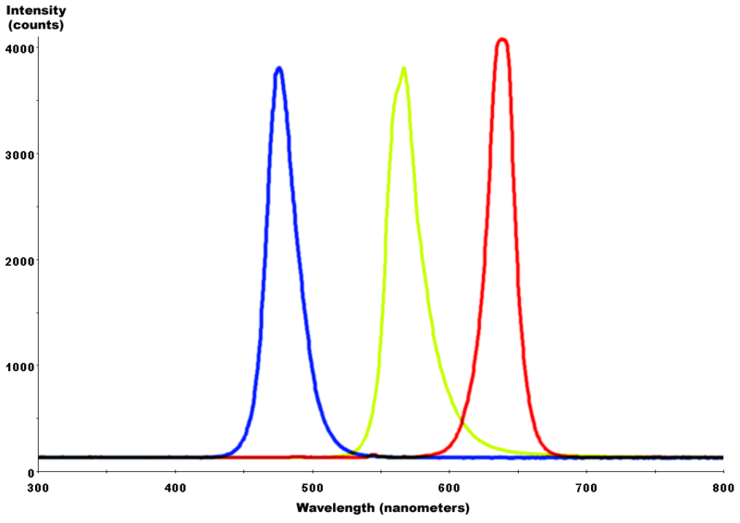
Color
Visible light : Power Vs Wavelength.
Each wave length is a color and higher the power brighter is the color.

Slide 4
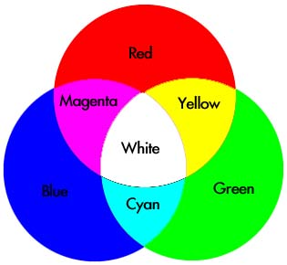
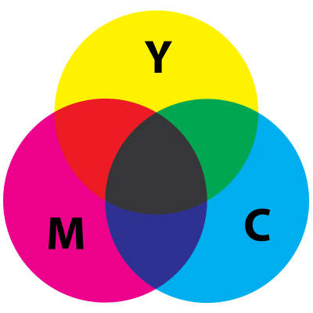
Color formation
Color works either in additive or Subtractive ways .
Additive color wheel and subtractive color wheel

Slide 5
Color Vision
Human eye has cone cells which see color in short (S, 420–440 nm), middle (M, 530–540 nm), and long (L, 560–580 nm) wavelengths.
3 Primary colors Red Green and Blue can be added to reproduce a color.

Slide 6
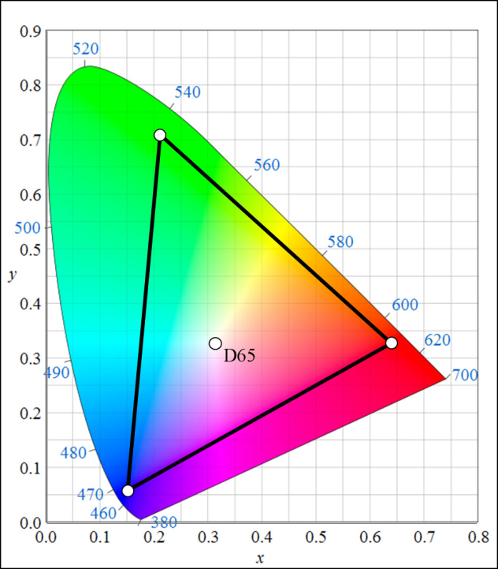
Color Space
Color space is the way to map colors.
CIE(International Commission on Illumination) 1976 is a uniform color space mapping

Slide 7
See-through display device

Slide 8
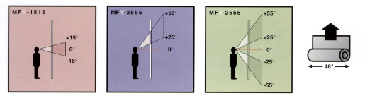
See- through display
A see-though display device is a digital display device which augments physical world with digital content.
Our display is Lumisty sheet.

Slide 9
Problems

Slide 10
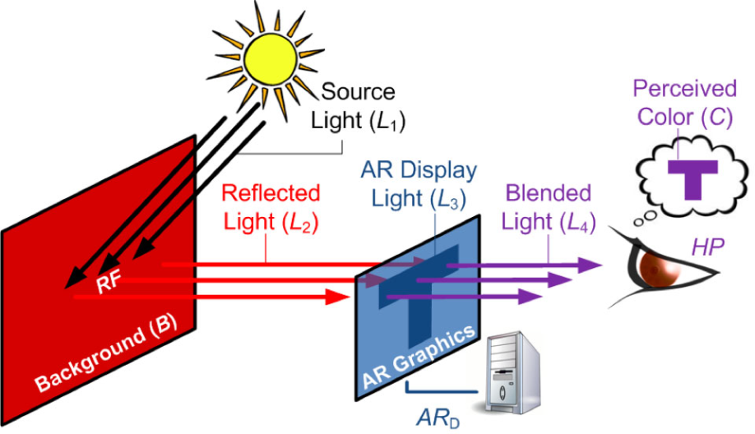
Problems in see-through display caused by colors
Real world background color affects the displayed contents on the digital display

Slide 11
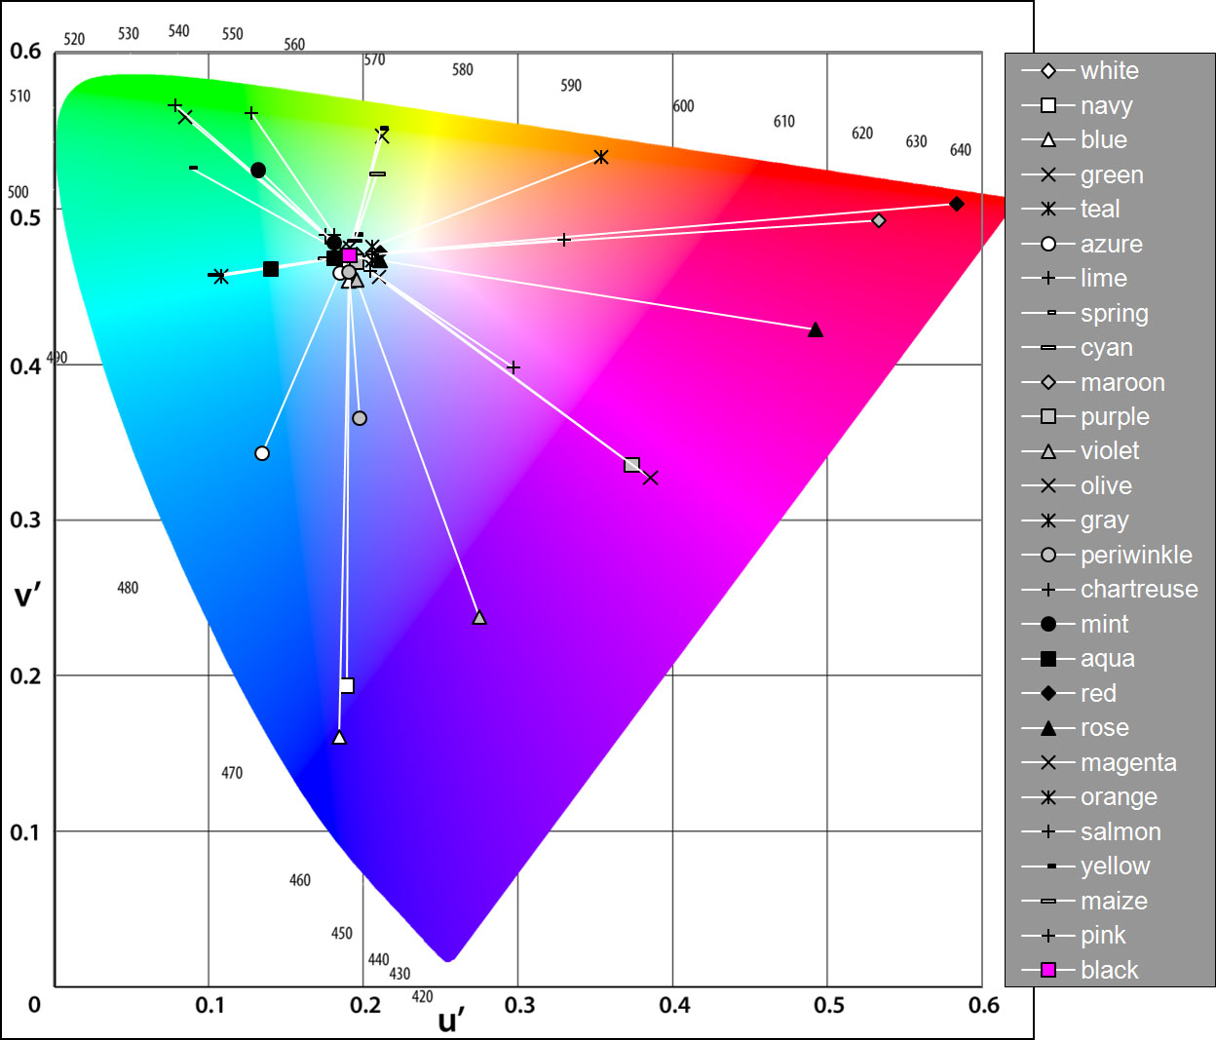
Color changes between the no-background condition
(outer values) and the white background (inner values)

Slide 12
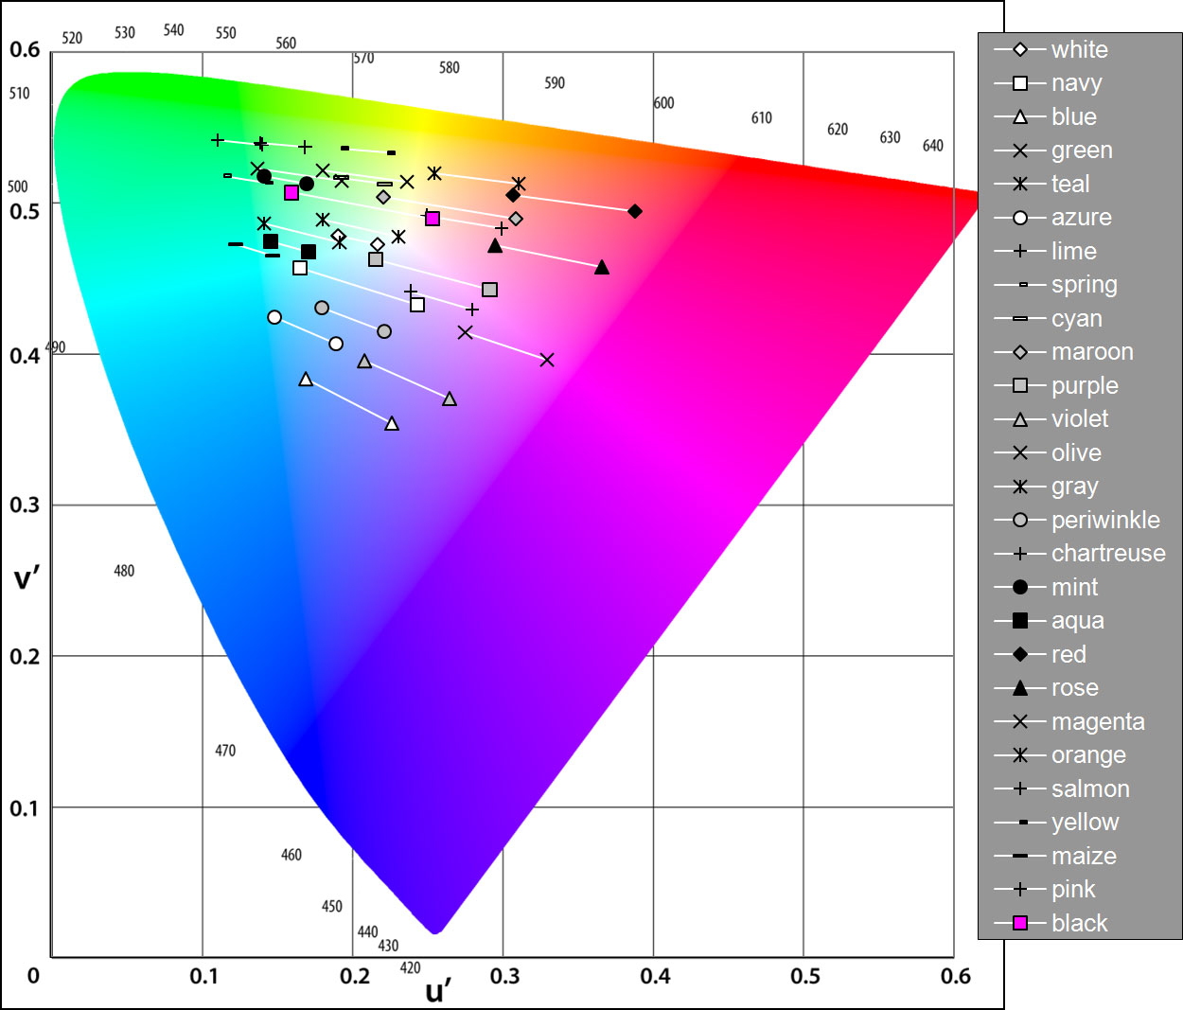
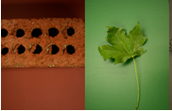
Chromatic changes between the brick background
(right-hand values) and the foliage background (left-hand values).

Slide 13
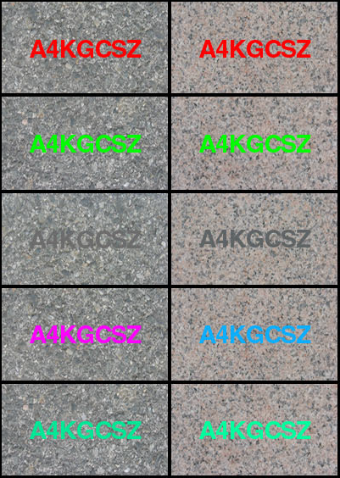
Poor contrast between foreground digital color and background physical world color.

Slide 14
Resulting perceptual problems
Content legibility issues.
Loss of color coded information.
Designers not having control over the intended content color.

Slide 15
Present solutions
Shifting the layout of the foreground digital display based on the background.
Making the contents opaque.
Making the opaque text with a contrasting color.

Slide 16
Solution Methodology

Slide 17
Approach
To design a system which will understand the background and will dynamically change the foreground digital color.
This system will preserve color.
By predicting the perceived color and applying a color correction.
Will preserve contrast by preserving color.
To design a software application which aids designs to create content on a see-through display.
We will implement all this on a single color physical background.

Slide 18
U OF M
U OF M

Slide 19
System Design
System
Color Prediction Model
Background and Foreground Color feeder
Corrected Foreground Color
Color-Correction Algorithm

Slide 20
Experimental design

Slide 21
Experiment 1 a :Model Derivation
Feed number of digital foreground and background colors to the system.
Shifts are plotted in CIE1976 using a color measuring instruments.
Then these shifts are fitted into a function.
Fitting function should predict the perceived color for any set of random foreground and background colors.

Slide 22
Experiment 1 b :Model validation
The predicted color will again be measured by a color measuring instruments.
Human trails will be conducted
The distance between models color’s shift point and human trail color’s shift point should be less than the distance between the intended color and the human trail color’s shift point.

Slide 23
Human Trail
Model’s Prediction
Original color

Slide 24
Experiment 2 :Color Correction
Will receive the perceived color from the model.
Will cross check it with the intended display color.
Adjust the display color to give the correct color orientation in the display.
Will use approximation algorithm.
Will again give back the generated color back to the model for cross checking.

Slide 25
Application

Slide 26
Features
Will have option to preserve color.
Will sample out the given background and will generate a color pallet for the colors which system can guarantee preservation.
Digital background options.
Optional Background

Slide 27
Open Questions
What can be the color term used for this problem?
How can we go forth with the human trail?
What will be compelling cases for using this?

Slide 28
Thank you

